Slide 1
APPLIED CAPESTONE DATA SCIENCE PROJECT
THE BATTLE OF NEIGHBOURHOODS - CHENNAI

Slide 2
BUSINESS PROBLEM:
• Chennai has a huge number of hotels, multiplexes, theatres etc. everyone around. So, starting a business in a perfect landmark would be a toughest job for one with new business ideas.
• Here using the best ways of Data Science, using clustering algorithm-Battle Of Neighborhoods, perfect spots to start several hot topic-business can be extracted at ease.
• The following project helps people to start a Hotel, Gym, shopping mall etc. in a perfect spot as wished.

Slide 3
API & METHODS USED:
The Foursquare API
k-means Clustering Algorithm
Silhouette Score
One hot Encoding
Folium visualization library

Slide 4
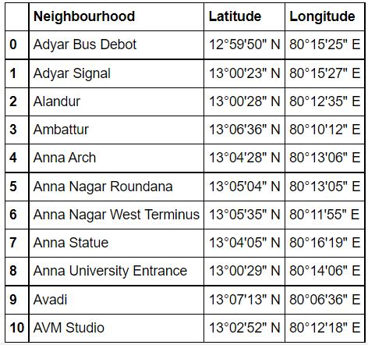
DATASET OF NEIGHBOURHOODS – CHENNAI:

Slide 5
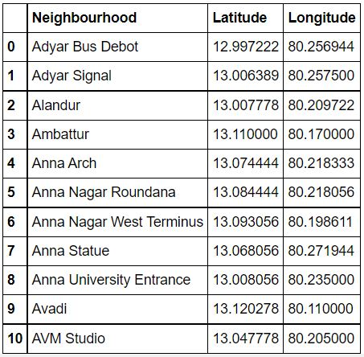
CONVERSION OF deg'min'sec" TO DECIMALS:

Slide 6
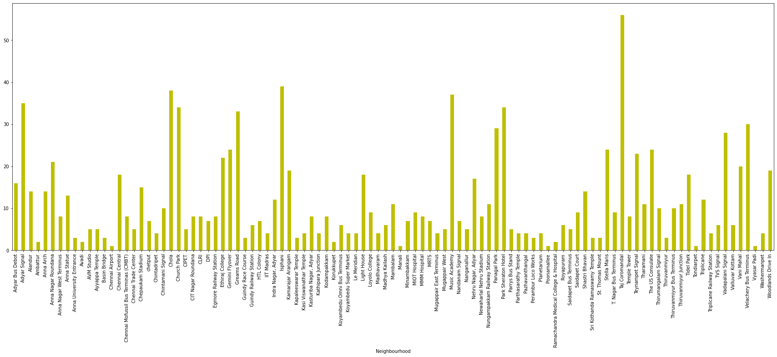
ANALYSIS & VISUALIZATION OF NO. OF VENUES:

Slide 7
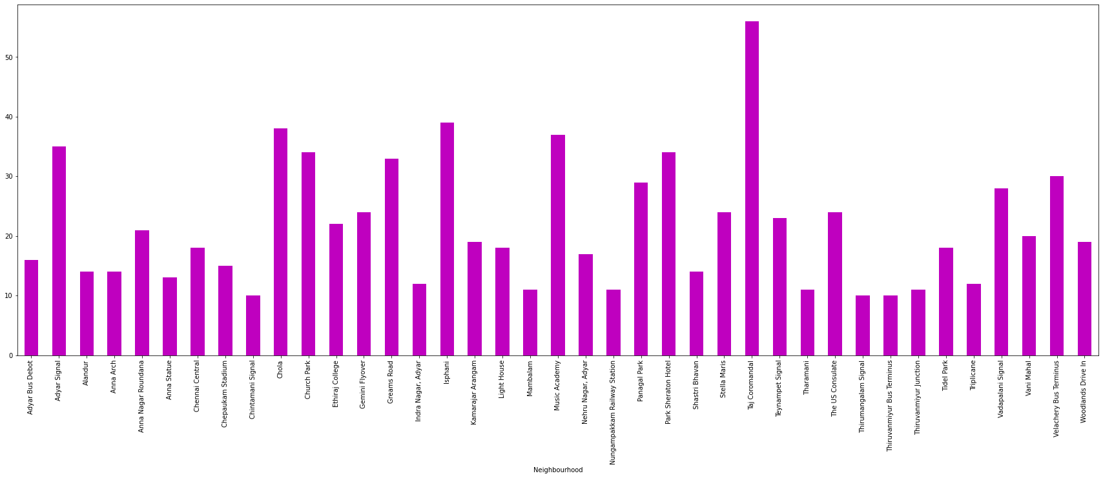
DROPPING NEIGHBOURHOODS WITHVENUES < 10:

Slide 8
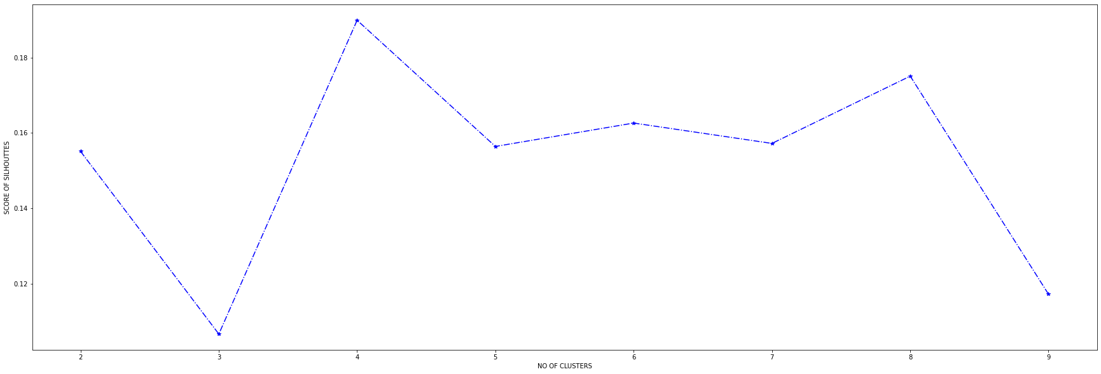
SILHOUTTE SCORING:

Slide 9
CLUSTERING LOGIC:
• Here the best silhouette score is equal to 8.
• So, a total of 8 number of clusters are going to be formed.
• By adding cluster_labels and with a new dastaframe Chennai_merged, a table with the 10 most common venues have been obtained.

Slide 10
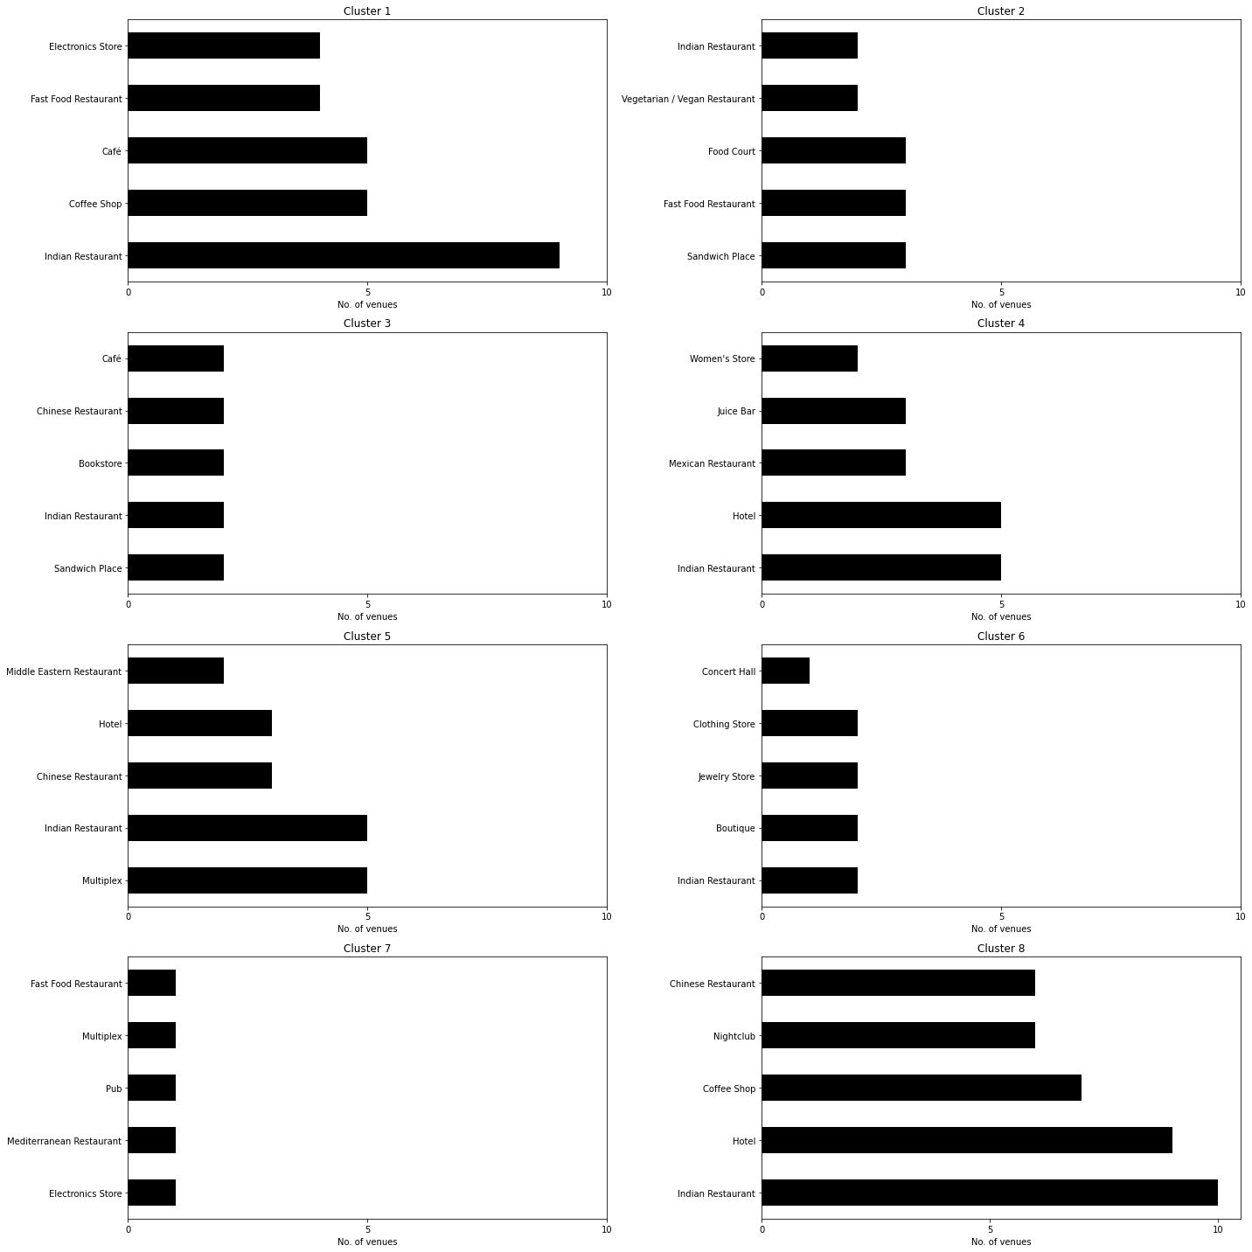
BAR GRAPHS OF TOP 5 VENUES:

Slide 11
SOLUTION EXAMPLE:
Cluster 1 and Cluster 8 have huge number of hotels. It would be the wrong choice for opening a hotel.
So, the perfect option would be Cluster 4 and Cluster 5 as it has a decent number of hotels and most importantly other entertainment zones that also attracts wayfarers towards the hotel.

Slide 12
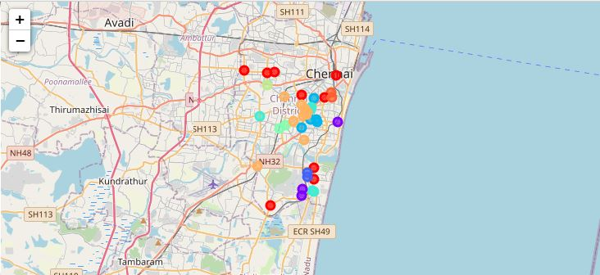
CLUSTERED MAP FOR SEVERAL BUSINESS FILEDS:

Slide 13
CONCLUSION:
• Thus a clustering model(Battle of neighborhoods) has been successfully developed which is tremendously useful for people with ideas of starting a Business in the discussed fields.
• The data related to the Neighborhoods of Chennai has been obtained and Foursquare API was used to find the venues of neighborhoods.
• As there were certain neighborhoods with venues < 10 they were dropped and venues > 10 were taken into account.
• Clustering is done by using k-nearest algorithm and optimal no. of clusters by silhouette scoring.
• An example for the project has been discussed. This would be so much useful for people with new and fresh business ideas.

Slide 14
THANK YOU

